Slide 1
Software Engineering
Software Design

Slide 2
Software Design
Deriving a solution which satisfies software requirements

Slide 3
Stages of Design
Problem understanding
  Look at the problem from different angles to discover the
  design requirements.
Identify one or more solutions
  Evaluate possible solutions and choose the most appropriate depending on the designer's experience and available resources.
Describe solution abstractions
  Use graphical, formal or other descriptive notations to
  describe the components of the design.
Repeat process for each identified abstraction
until the design is expressed in primitive terms.

Slide 4
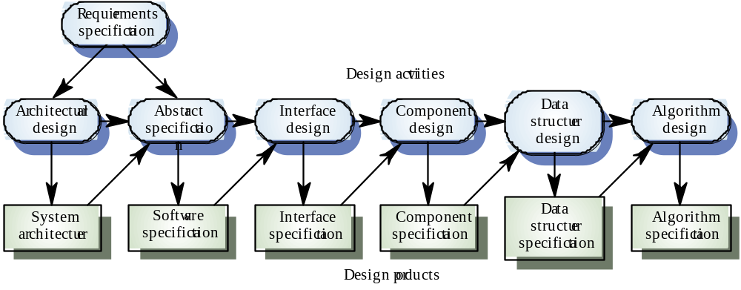
Phases in the Design Process

Slide 5
Design Phases
Architectural design: Identify sub-systems.
Abstract specification: Specify sub-systems.
Interface design: Describe sub-system interfaces.
Component design: Decompose sub-systems
into components.
Data structure design: Design data structures to hold problem data.
Algorithm design: Design algorithms for problem functions.

Slide 6
Design
The goal of system design is to decode:
  What the modules are;
  What the modules should be;
  How the modules interact with one-another

Slide 7
Five Criteria for Design Methods
We can identify five criteria to help evaluate modular design methods:
  Modular decomposability;
  Modular composability;
  Modular understandability;
  Modular continuity;
  Modular protection.

Slide 8
Modular Decomposability
This criterion is met by a design method if the method supports the decomposition of a problem into smaller sub-problems, which can be solved independently.
In general method will be repetitive: sub-problems will be divided still further
Top-down design methods fulfil this criterion; stepwise refinement is an example of such method

Slide 9
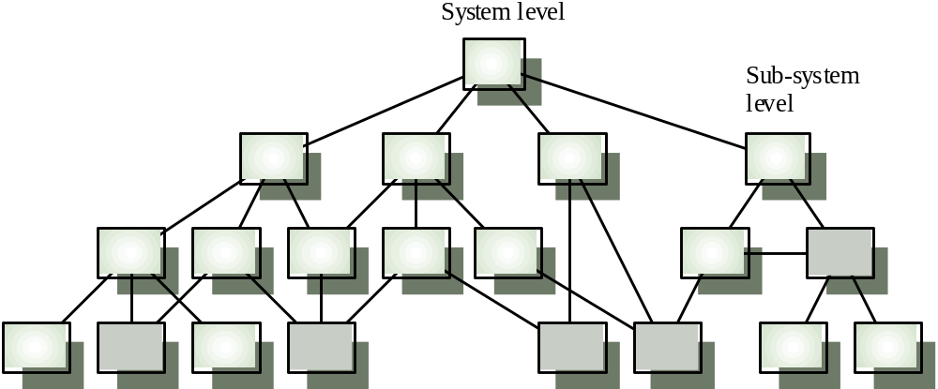
Hierarchical Design Structure

Slide 10
Top-down Design
In principle, top-down design involves starting
at the uppermost components in the hierarchy
and working down the hierarchy level by level.
In practice, large systems design is never
truly top-down. Some branches are designed before others. Designers reuse experience (and
sometimes components) during the design
process.

Slide 11
Modular Composability
A method satisfies this criterion if it leads to the production of modules that may be freely combined to produce new systems.
Composability is directly related to the issue of reusability
Note that composability is often at odds with decomposability; top-down design,
  for example, tends to produce modules that may not be composed in the way desired
This is because top-down design leads to modules which fulfil a specific function, rather than a general one

Slide 12
Modular Understandability
A design method satisfies this criterion if it encourages the development of modules which are easily understandable.
COUNTER EXAMPLE 1. Take a thousand lines program, containing no procedures; it’s just a long list of sequential statements. Divide it into twenty blocks, each fifty statements long; make each block a method.
COUNTER EXAMPLE 2. “Go to” statements.

Slide 13
Understandability
Related to several component characteristics
  Can the component be understood on its own?
  Are meaningful names used?
  Is the design well-documented?
  Are complex algorithms used?
Informally, high complexity means many
relationships between different parts of the
design.

Slide 14
Modular Continuity
A method satisfies this criterion if it leads to the production of software such that a small change in the problem specification leads to a change in just one (or a small number of ) modules.
EXAMPLE. Some projects enforce the rule that no numerical or textual literal should be used in programs: only symbolic constants should be used
COUNTER EXAMPLE. Static arrays (as opposed to open arrays) make this criterion harder to satisfy.

Slide 15
Modular Protection
A method satisfied this criterion if it yields architectures in which the effect of an abnormal condition at run-time only effects one (or very few) modules
EXAMPLE. Validating input at source prevents errors from propagating throughout the program.
COUNTER EXAMPLE. Using int types where subrange or short types are appropriate.

Slide 16
Five principles for Good Design
From the discussion above, we can distil five principles that should be adhered to:
  Linguistic modular units;
  Few interfaces;
  Small interfaces
  Explicit interfaces;
  Information hiding.

Slide 17
Linguistic Modular Units
A programming language (or design language) should support the principle of linguistic modular units:
  Modules must correspond to linguistic units in the language used
EXAMPLE. Java methods and classes
COUNTER EXAMPLE. Subroutines in BASIC are called by giving a line number where execution is to proceed from; there is no way of telling, just by looking at a section of code, that it is a subroutine.

Slide 18
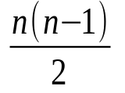
Few Interfaces
This principle states that the overall number of communication channels between modules should be as small as possible:
  Every module should communicate with as few others as possible.
So, in the system with n modules, there may be a minimum of n-1 and a maximum of links; your system should stay closer to the minimum

Slide 19
Small Interfaces (Loose Coupling)
This principle states:
  If any two modules communicate, they should exchange as little information as possible.
COUNTER EXAMPLE. Declaring all instance variables as public!

Slide 20
Coupling
A measure of the strength of the inter-connections between system components.
Loose coupling means component changes are unlikely to affect other components.
  Loose coupling can be achieved by state decentralization (as in objects) and component communication via parameters or message passing.

Slide 21
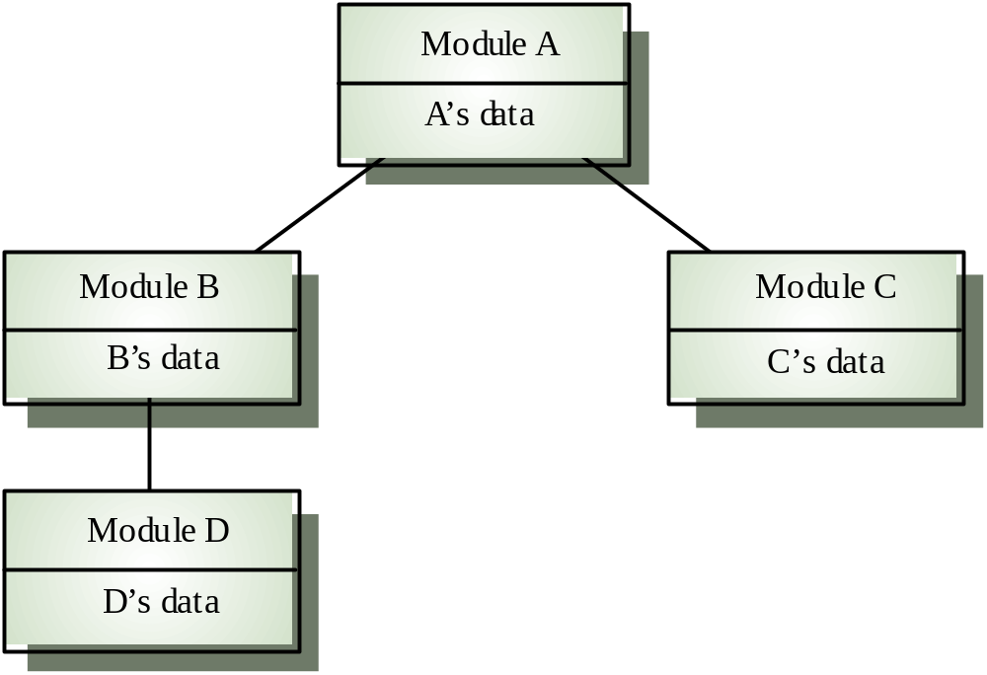
Loose Coupling

Slide 22
Coupling and Inheritance
Object-oriented systems are loosely coupled because there is no shared state and objects communicate using message passing.
However, an object class is coupled to its
super-classes. Changes made to the attributes
or operations in a super-class propagate to all
sub-classes.

Slide 23
Reusability
A major obstacle to the production of cheap quality software is the intractability of the reusability issue.
Why isn’t writing software more like producing hardware? Why do we start from scratch every time, coding similar problems time after time after time?
Obstacles:
  Economic;
  Organizational;
  Psychological.

Slide 24
Explicit Interfaces
If two modules must communicate, they must do it so that we can see it:
  If modules A and B communicate, this must be obvious from the text of A or B or both.
Why? If we change a module, we need to see what other modules may be affected by these changes.

Slide 25
Information Hiding
This principle states:
  All information about a module, (and particularly how the module does what it does) should be private to the module unless it is specifically declared otherwise.
Thus each module should have some interface, which is how the world sees it anything beyond that interface should be hidden.
The default Java rule:
  Make everything private

Slide 26
Cohesion
A measure of how well a component “fits
together”.
A component should implement a single logical
entity or function.
Cohesion is a desirable design component
attribute as when a change has to be made, it
is localized in a single cohesive component.

